Slide 1
PREDICTION FOR CANCELLATION STATUS OF HOTEL BOOKINGS
-119EC0020
-SALAMULLA.G

Slide 2
Libraries used
Numpy
Pandas
Matplotlib
Seaborn
Scikit

Slide 3
DATA and visualization
In order to forecast the state of hotel booking cancellations, our data includes 32 features.
These 32 elements provide a variety of explanations for the various dimensions of hotel reservations.
Our dataset includes these features, such as arrivals, stays, cancellations, , Reservations, etc.

Slide 4
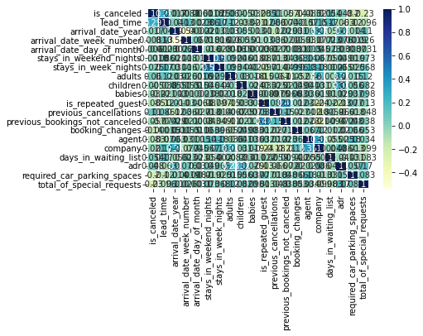
Correlation visualization
It is used to determine change one variable is it affect another variable.It will be ranging from -1 to +1

Slide 5
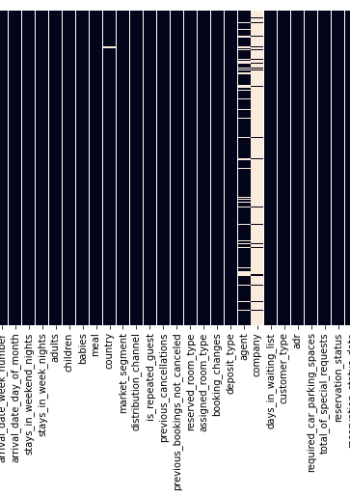
Heatmap (NULL DATA VISUALIZATION)
While checking the null values for the features ,we have got
Features null values
Children 4
Country 488
Agent 16340 company 112593
Remaining features 0

Slide 6
Inference for the above data
First,we have the correlated the features of the dataset in order to get the relationship between the features.
Then, after examining all of the null values for each feature, we discovered that the feature titled "company" has a high null value. Therefore, that company information can be removed from the dataset.
They will substitute the median, mode, and mean of the remaining non-null data in that feature for the remaining features that have null values.

Slide 7
data Preprocessing
Different datatypes are present in our data. We utilise label encoder to add to the single datatype.
All of the features can be converted to the same datatype using fit transform.
It will be challenging to apply machine learning algorithms to the dataset without data preprocessing, so we cannot move on to the next step.

Slide 8
Splitting the data
We will be using two variables X and Y
Y with only ‘is canceled’ feature and X with the remaining features
Next step is to split the X into train data and test data with testdata size : 0.4
Similarly,Y is split into train data and test data with testdata size : 0.4

Slide 9
Accuracy check for different algorithms
For accuracy we will be using different classifiers which we have imported from scikit libraries.
First,we have used logistic regression got test accuracy score and train accuracy score around 0.989.
Then we have gone through several classifiers in order to improve the accuracy score than the logistic regression.
The accuracy score for the decision tree is 100% and we will be decision tree classifier in our model.

Slide 10
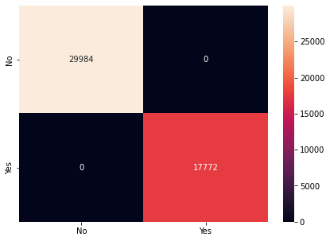
Confusion matrix for decision tree

Slide 11
conclusion
It breaks down a dataset into smaller and smaller subsets while at the same time an associated decision tree is incrementally developed.
Here we have used the criterion ‘gini’ and max depth 3.
Thus,By accuracy score and confusion matrix we can conclude that decision tree classifier is the best.

